Slide 1
Unit 203: Electrical installations technology
Lighting circuits

Slide 2
Lighting circuits
Points to note
All lighting points, unless specific light sources with known power ratings are being used, are assumed to have a rating of 100 watts minimum.
In order to ensure that there is not a complete blackout when a fault occurs, we should install at least two lighting circuits in the premises.
Earthing terminal and cpc must be provided at all lighting points, including switches and ceiling roses.
5/6 amp protective devices are normally used to protect domestic lighting circuits (5 amp if BS3036 semi-enclosed rewireable fuse; 6 amp if a circuit breaker).
Domestic lighting circuits are generally wired in 1.0mm² or 1.5mm² cables.

Slide 3
Lighting circuits
Two types of wiring system are used for lighting circuits:
two-plate system – used where single-core cables are used, eg in conduit and trunking systems.
three-plate system – used where multi-core cables are used, eg domestic installations using twin and earth.

Slide 4
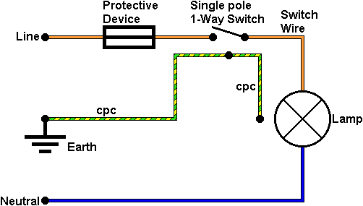
Lighting circuits
Practical lighting circuits – two-plate
One-way switching
Points to note.
Single pole switches and protective devices must be installed in the line conductor only.
For Edison Screw (ES) lamp holders the line conductor must be connected to the centre contact of the lamp holder.

Slide 5
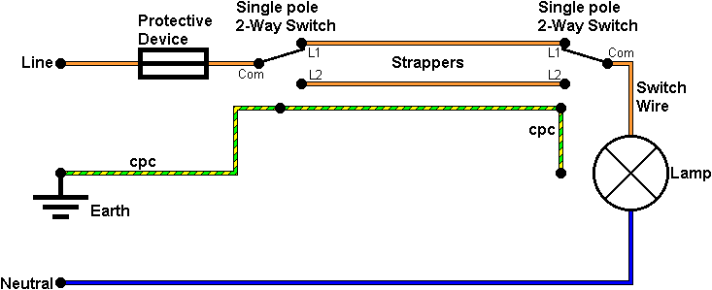
Lighting circuits
Practical lighting circuits – two-plate
Two-way switching

Slide 6
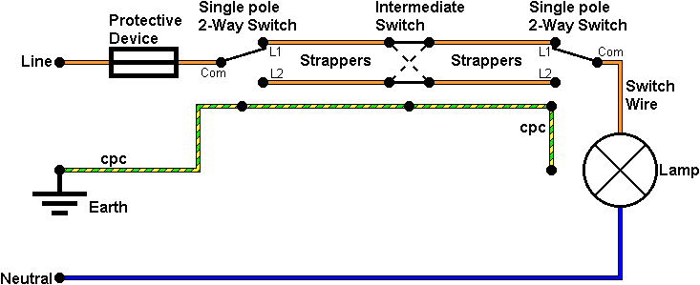
Lighting circuits
Practical lighting circuits – two-plate
Two-way and intermediate switching

Slide 7
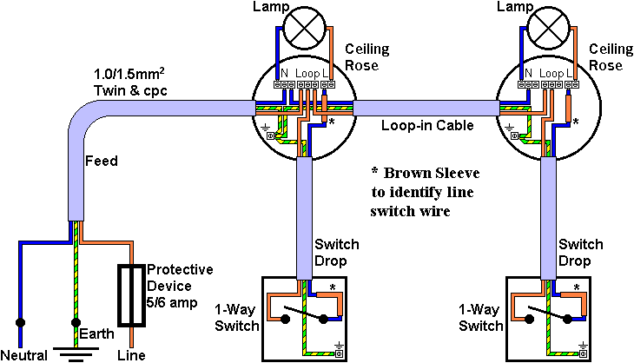
Lighting circuits
Practical lighting circuits – three-plate
One-way lighting circuit

Slide 8
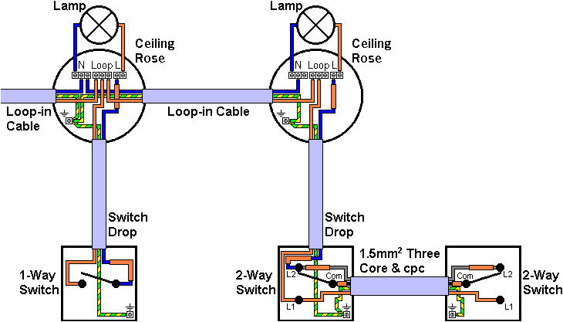
Lighting circuits
Practical lighting circuits – three-plate
Two-way conversion lighting circuit

Slide 9
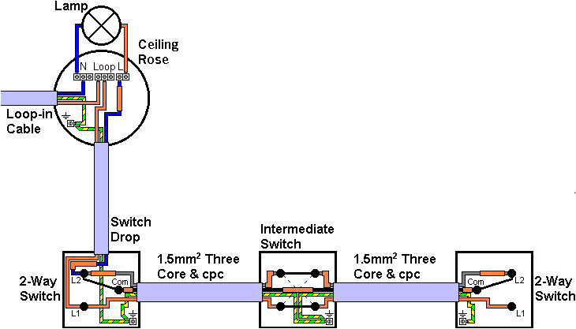
Lighting circuits
Practical lighting circuits – three-plate
Intermediate switches in the two-way conversion lighting circuit

Slide 10
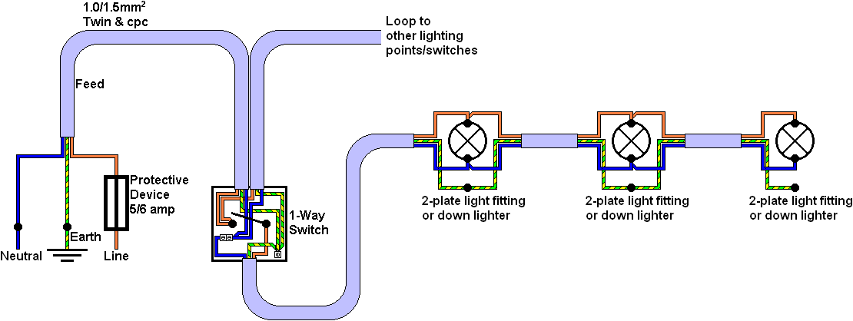
Lighting circuits
Looping at switches

Slide 11
Unit 203: Electrical installations technology
The End

